Slide 1
Servlets Request and Response

Slide 2
Servlets Request
An object of ServletRequest is used to provide the client request information to a servlet such as content type, content length, parameter names and values, header informations, attributes etc.
Some header informations are
Accept E.g "*/*" indicating all media types
Accept-Charset
Accept-Encoding
Accept-Language
Authorization
Connection
Content-Length
Cookie
Host

Slide 3
Servlet methods
Cookie[] getCookies()
Returns an array containing all of the Cookie objects the client sent with this request.
Enumeration getAttributeNames()
Returns an Enumeration containing the names of the attributes available to this request.
HttpSession getSession(boolean create)
Returns the current HttpSession associated with this request or, if if there is no current session and value of create is true, returns a new session.

Slide 4
Servlet methods
public String getParameter(String name) - is used to obtain the value of a parameter by name.
public int getContentLength() - Returns the size of the request entity data, or -1 if not known.
public String getContentType() - Returns the Internet Media Type of the request entity data, or null if not known.
public abstract String getServerName() - Returns the host name of the server that received the request.
public int getServerPort() - Returns the port number on which this request was received.

Slide 5
HTTP Header Request Example
import java.io.*; import javax.servlet.*; import javax.servlet.http.*; import java.util.*;
public class DisplayHeader extends HttpServlet {
public void doGet(HttpServletRequest request, HttpServletResponse response)
throws ServletException, IOException
{
response.setContentType("text/html");
PrintWriter out = response.getWriter();
String title = "HTTP Header Request Example";
String docType ="<!doctype html public \"-//w3c//dtd html 4.0 " + "transitional//en\">\n";

Slide 6
HTTP Header Request Example
out.println(docType +
"<html>\n" +
"<head><title>" + title + "</title></head>\n"+
"<body bgcolor = \"#f0f0f0\">\n" +
"<h1 align = \"center\">" + title + "</h1>\n" +
"<table width = \"100%\" border = \"1\" align = \"center\">\n" +
"<tr bgcolor = \"#949494\">\n" +
"<th>Header Name</th><th>Header Value(s)</th>\n"+
"</tr>\n"
);

Slide 7
HTTP Header Request Example
Enumeration headerNames = request.getHeaderNames();
while(headerNames.hasMoreElements()) {
String paramName = (String)headerNames.nextElement();
out.print("<tr><td>" + paramName + "</td>\n");
String paramValue = request.getHeader(paramName);
out.println("<td> " + paramValue + "</td></tr>\n");
}
out.println("</table>\n</body></html>");
}
}

Slide 8
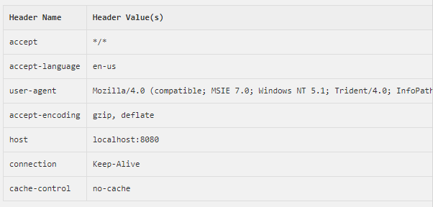
HTTP Header Request Example O/P

Slide 9
Server HTTP Response
Web server responds to an HTTP request, the response typically consists of a status line, some response headers, a blank line, and the document.
The status line consists of the HTTP version (HTTP/1.1 in the example), a status code (200 in the example), and a very short message corresponding to the status code (OK in the example).

Slide 10
HTTP Response Header
HTTP response header in your servlet program.
boolean containsHeader(String name)
void addCookie(Cookie cookie)
void addDateHeader(String name, long date)
void flushBuffer()
void resetBuffer()
void setBufferSize(int size)
void setStatus(int sc)

Slide 11
HTTP Response Header Example
// Import required java libraries
import java.io.*; import javax.servlet.*; import javax.servlet.http.*; import java.util.*;
public class Refresh extends HttpServlet {
public void doGet(HttpServletRequest request, HttpServletResponse response)
throws ServletException, IOException
{
response.setIntHeader("Refresh", 5);//automatic refreshing
response.setContentType("text/html");

Slide 12
HTTP Response Header Example
// Get current time
Calendar calendar = new GregorianCalendar();
String am_pm;
int hour = calendar.get(Calendar.HOUR);
int minute = calendar.get(Calendar.MINUTE);
int second = calendar.get(Calendar.SECOND);
if(calendar.get(Calendar.AM_PM) == 0)
am_pm = "AM";
else
am_pm = "PM";
String CT = hour+":"+ minute +":"+ second +" "+ am_pm;

Slide 13

HTTP Response Header Example
PrintWriter out = response.getWriter();
String title = "Auto Refresh Header Setting";
String docType =
"<!doctype html public \"-//w3c//dtd html 4.0 " + "transitional//en\">\n";
out.println(docType +
"<html>\n" +
"<head><title>" + title + "</title></head>\n"+
"<body bgcolor = \"#f0f0f0\">\n" +
"<h1 align = \"center\">" + title + "</h1>\n" +
"<p>Current Time is: " + CT + "</p>\n"
);
}
Output:

